Slide 1
Nearest-state-county-finder
JINGYI ZHANG, YUZHE XU, CYNTHIA YOUNG
Final report slide Dec 8th

Slide 2
Project Summarized
This project is to create a system, which can efficiently find the nearest state or county of the given input location.
In this system, users are asked to input the latitude and longitude of the targeted location, and are required to input how many K points they want to find.
To implement this, we loaded input data from USGS.
We used the Haversine Distance formula to compute distance
We used a KD tree to do the nearest neighbor search, and used majority voting to narrow down the state and county.

Slide 3
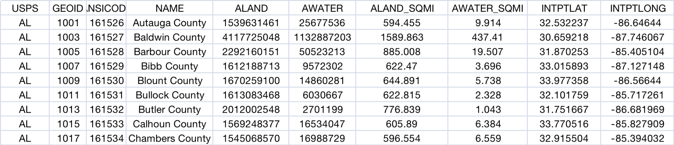
Files
Data < 2023_Gaz_counties_national.csv> : Downloaded from USGS. It includes the state (USPS) , county(NAME) , LATITUDE(INTPTLAT) and LONGITUDE (INTPTLONG), which are needed for finding nearest K reference points. We converted it from txt to the csv format to better extrapolate.
load.cpp: source code for finding the nearest state and county.
makefile: file used to compile load.cpp (make / make run)
input/output: .txt files for testing and outputting the result

Slide 4
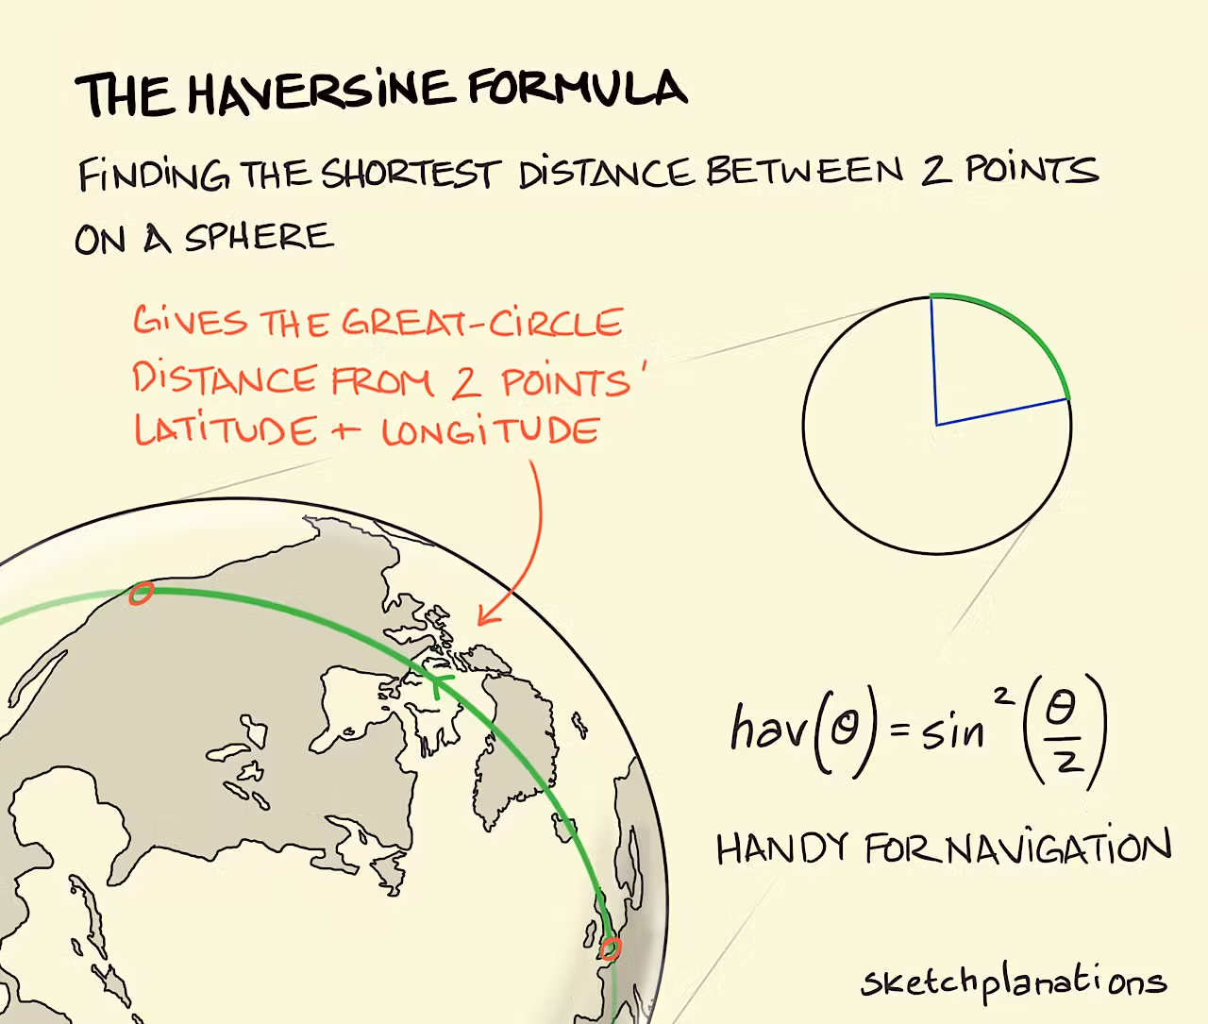
Method of Code
Distance Computation-Haversine Distance:
The distance between two points (reference point and input point) is calculated using the haversine distance, which involves latitude and longitude. a = sin²(Δlat/2) + cos(lat1) * cos(lat2) * sin²(Δlon/2)
c = 2 * atan2(sqrt(a), sqrt(1-a))
distance = R * c
R is the radius of the Earth
Haversine formula takes into account the curvature of the
Earth's surface, making it more accurate for longer distances
State and County Identification -majority voting :
Once the nearest K reference points are found, the system ,
perform a majority voting among the K nearest points,
to determine the state of the searched point.

Slide 5
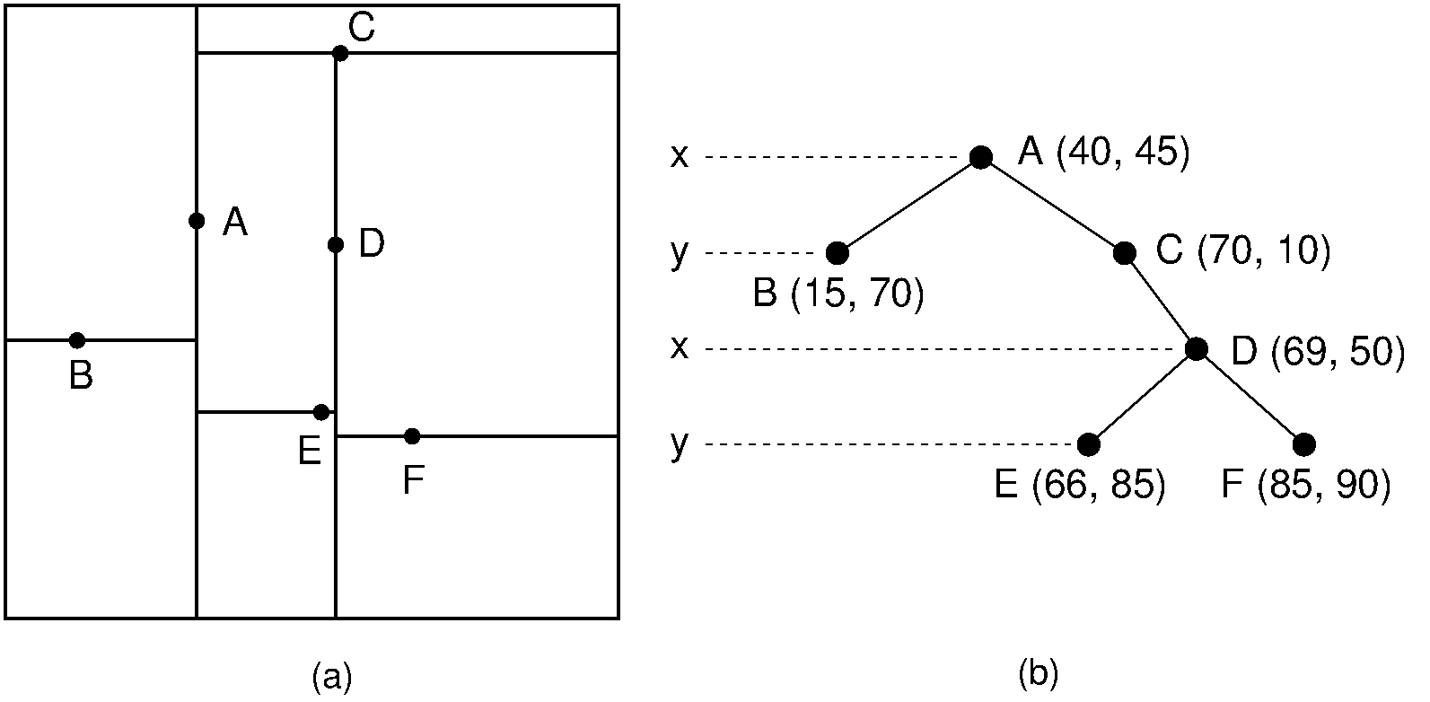
Method of Code: KD Tree
KD-Tree is a data structure that is particularly suitable for multi-dimensional space search queries
Efficient space division
When build the tree, insert points, effectively divides the space into smaller regions, each containing similar points
Fast nearest neighbor search
Suitable for nearest neighbor search
Quickly narrow down the search area

Slide 6
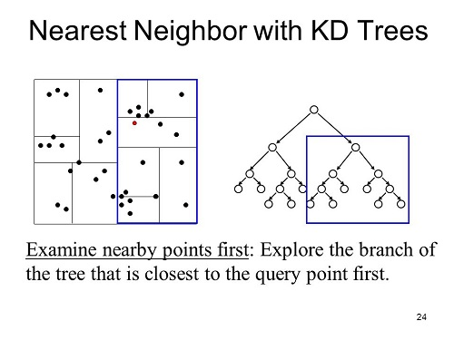
Method of Code: Nearest Neighbor Search
Checks if the current node is closer and then selects a subtree to search deeper. If there are closer points in the subtree then search path will be explored further
If the subtree on the other side is likely to contain a closer point, then that subtree
is also searched
Notes:
If the coordinates of the query point in the current dimension are less than the coordinates of the current node, the search continues in the "left" subtree of the current node; otherwise, in the "right" subtree.

Slide 7
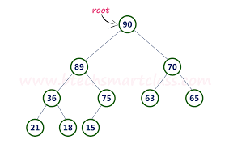
Method of Code: Max Heap
We used Max heap to store the closest points found and their distance from the query point. It allows us to efficiently keep track of the closest points found so far.
Compare new node with top of queue
If new node distance < top one
Top pop up
New node push in
Notes:
Before returning, the function checks whether it is necessary to search the subtree on the other side. This is determined by comparing the difference between the coordinates of the current node in the current dimension and the coordinates of the query point, and the distance of the farthest point in the priority queue.
If this distance is smaller than the distance of the farthest point in the priority queue, then there may be a closer point in the subtree on the other side, so the subtree on that side needs to be searched.

Slide 8
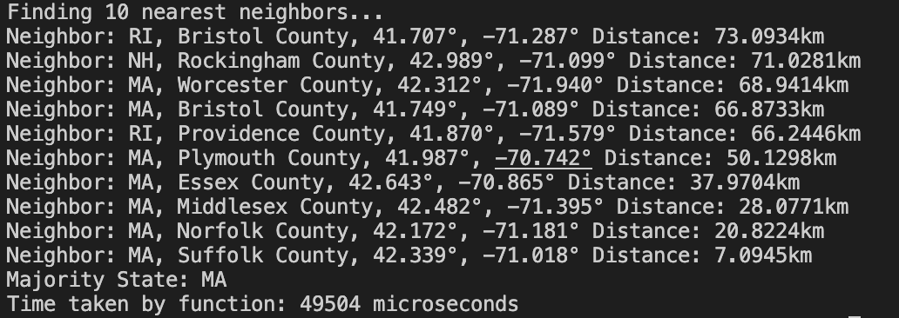
Input Output Example vs Real Points
BU CDS Building:
42.3499° N, -71.1032° W
State: MA (Massachusetts)
County: Suffolk

Slide 9
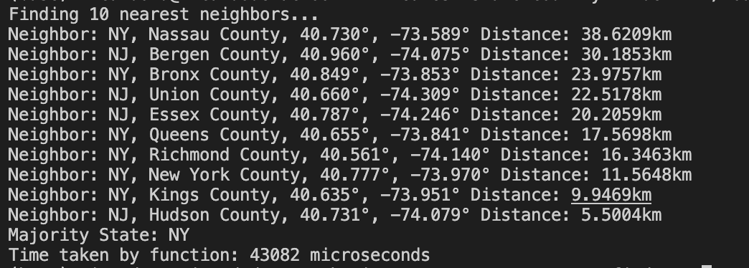
Statue of Liberty
Coordinates: 40.6892° N, 74.0445° W
State: NY (New York)
County: New York County

Slide 10
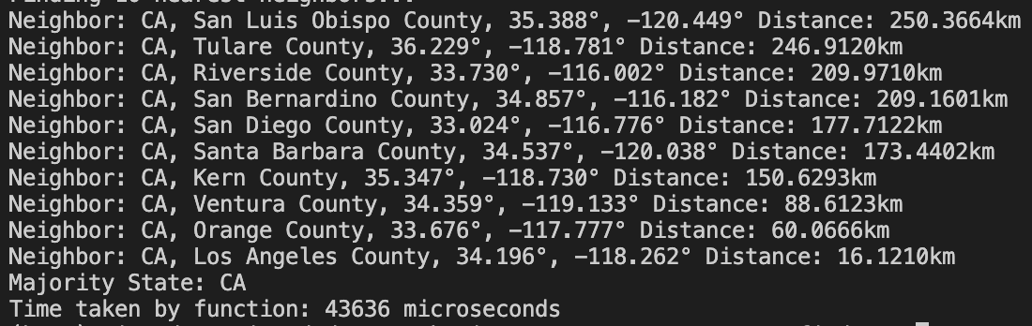
LA county
Coordinates: 34.0522° N, 118.2437° W
State: CA (California)
County: Los Angeles County

Slide 11
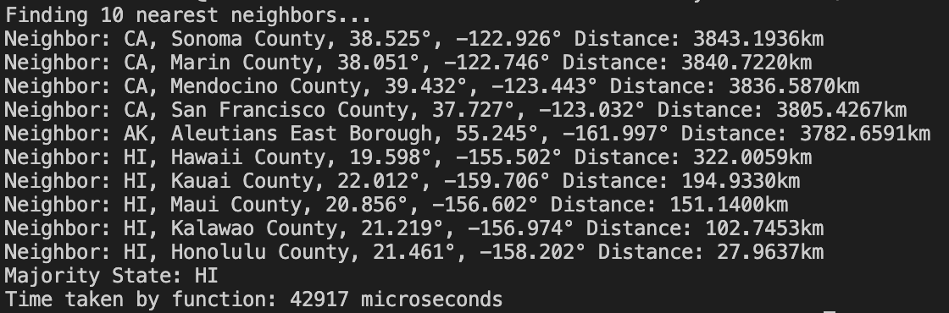
-157.95365360883602
Pearl Harbor in Hawaii
Latitude: 21.362374050539042
Longitude: -157.95365360883602 This is an edge test

